Slide 1
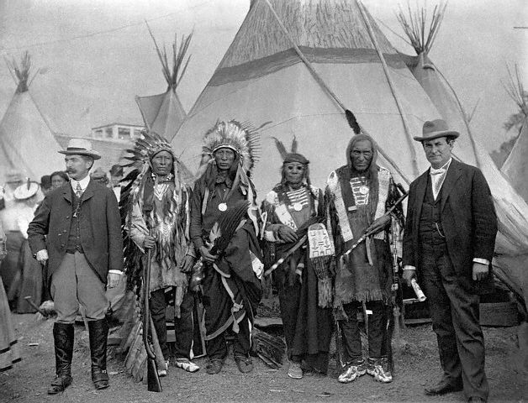
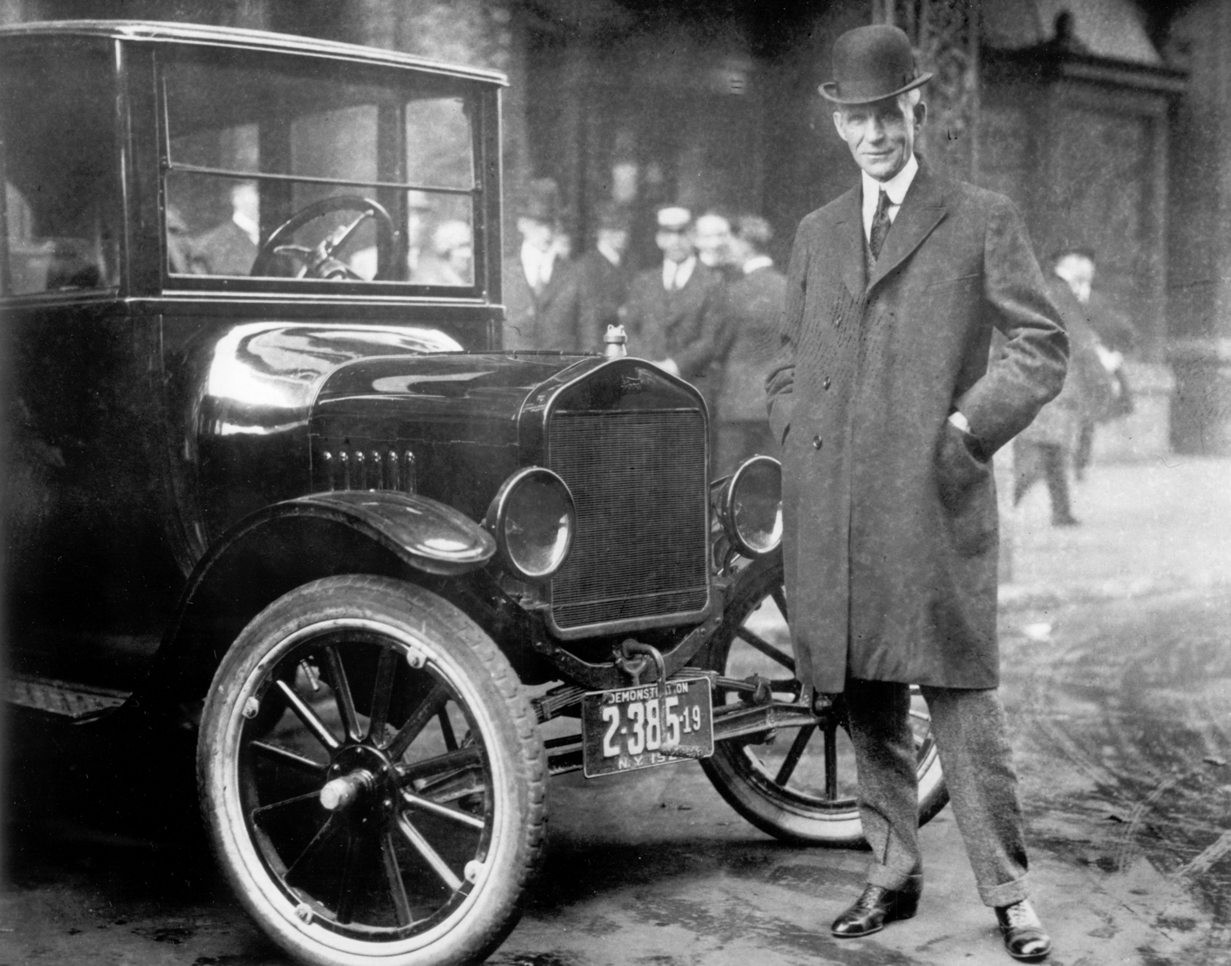
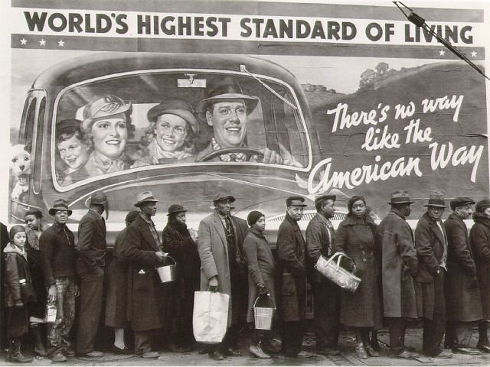
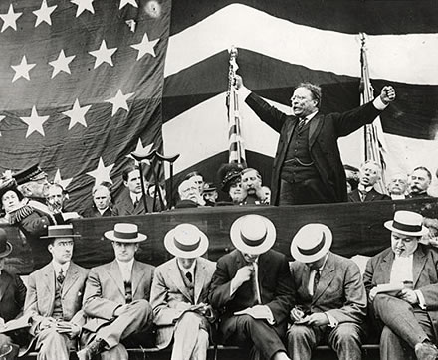
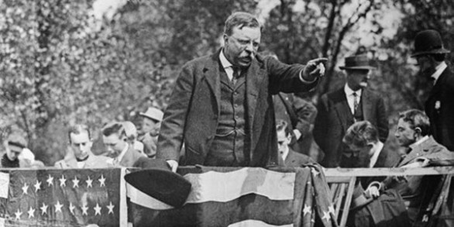
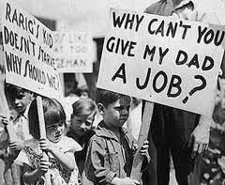
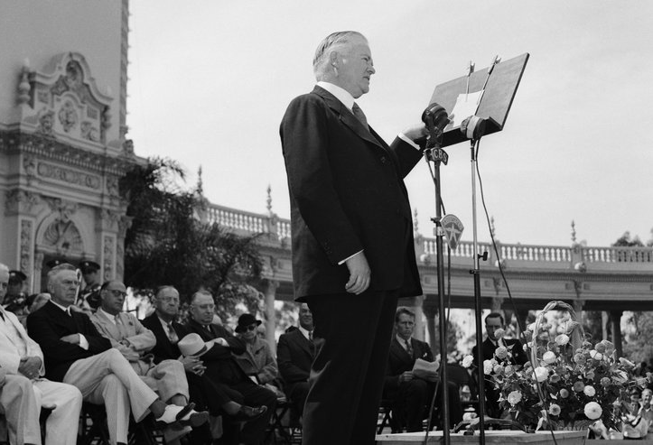
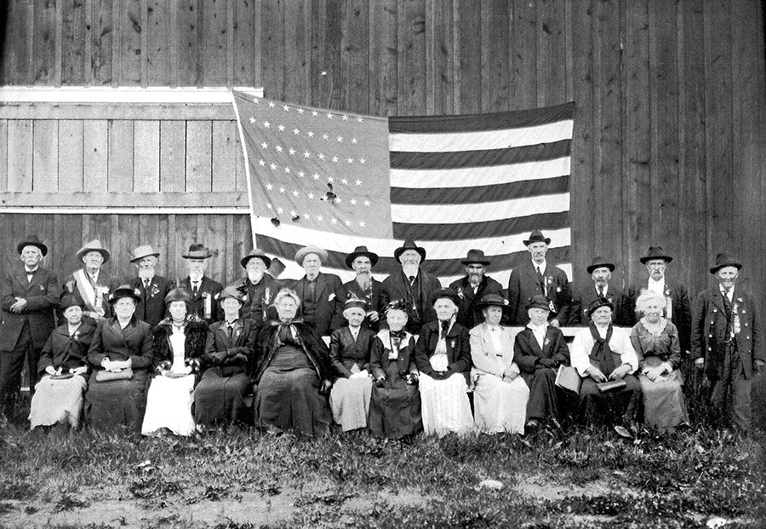
American glossary

Slide 2
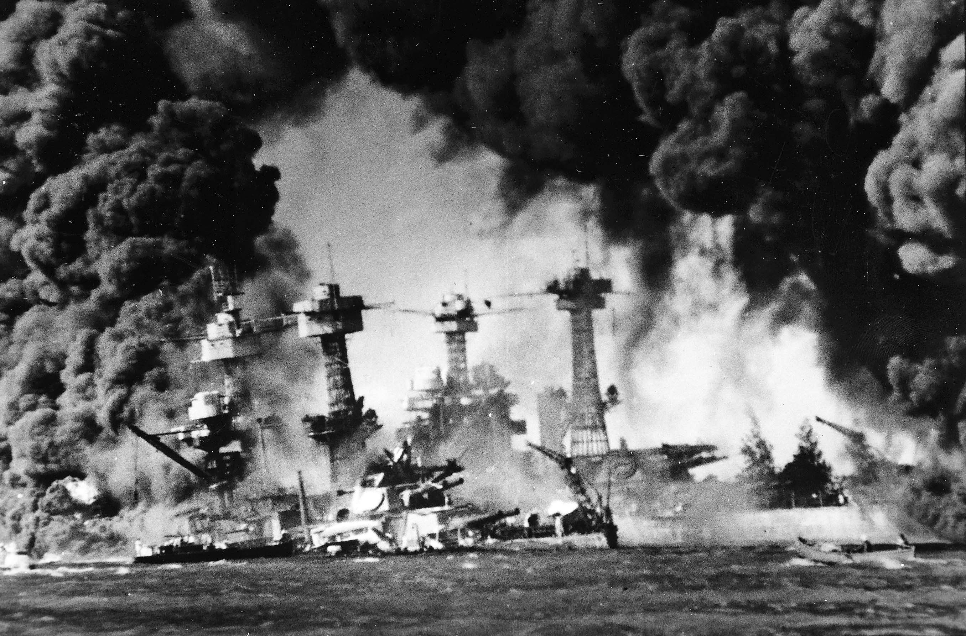
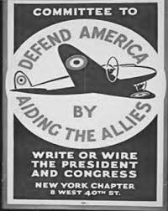
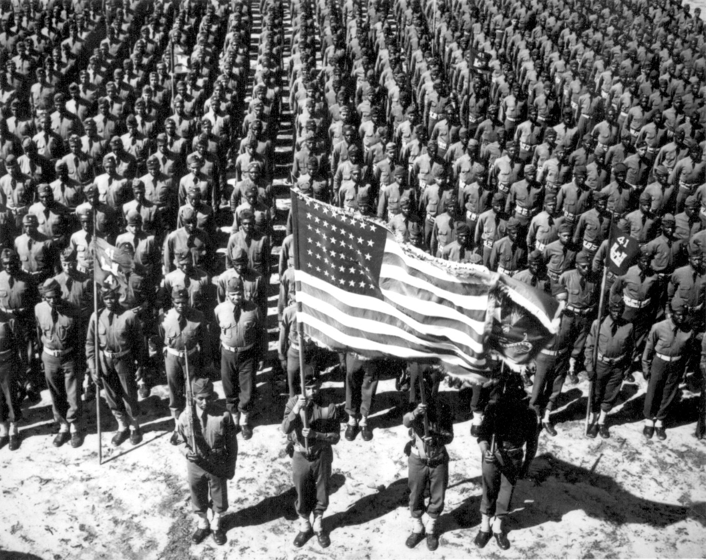
internationalism
Political principle which advocates for cooperation among nations, within politics and economics, for their common good.
America recoiled from internationalism in the 1930s as a direct result of the boom in public and political support of isolationism.
In September 1939 President Roosevelt called on congress to revise neutrality acts and offered a plan known as cash-and-carry.
In December 1941 America became involved in WWII after the Japanese attack on Pearl Harbour.

Slide 3
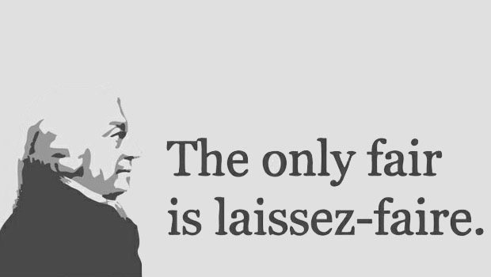
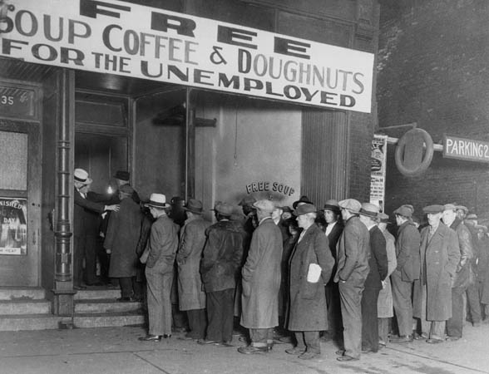
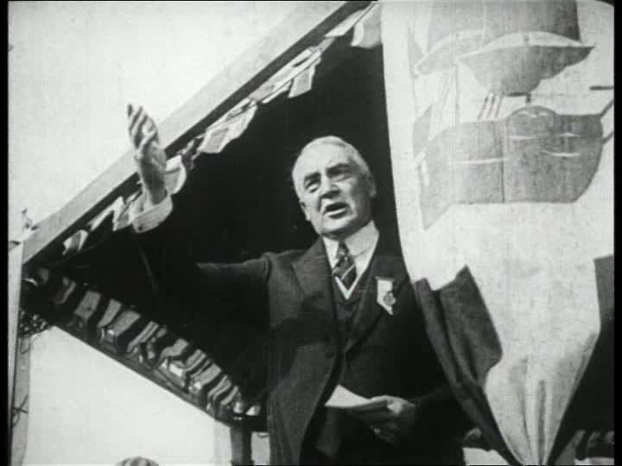
Laissez-faire
An economic system in which transactions between private parties are free from government interference.
The United States did not follow the principles of laissez-faire at first.
Private business saw government involvement in economics as interference after President Theodore Roosevelt began breaking up monopolies, so they ensured the election of three laissez-faire presidents in the 1920s.

Slide 4
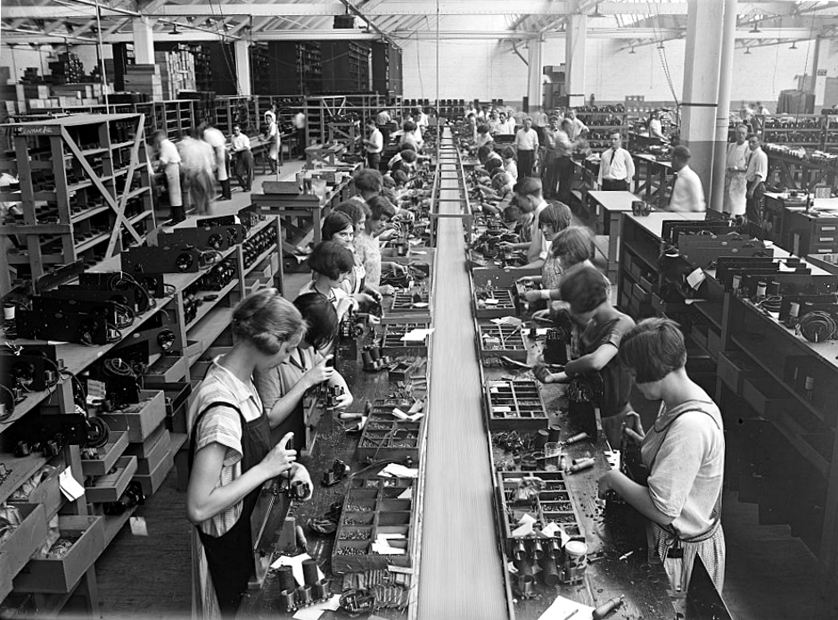
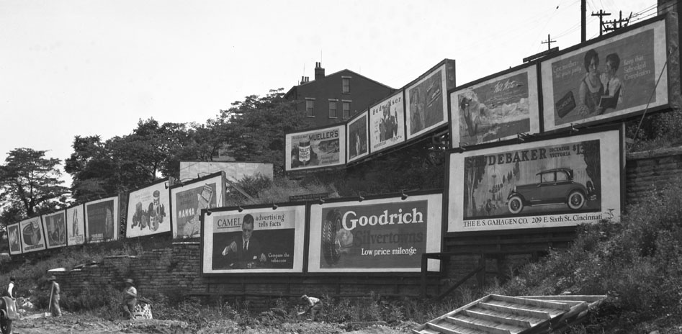
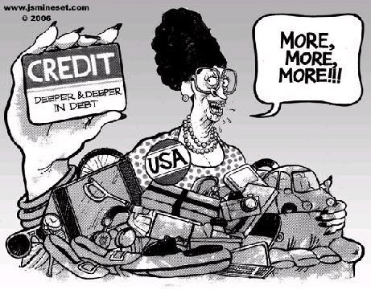
Consumerism
The belief that it is good for people to spend a lot of money on goods and services.
The theory that an increasing consumption of goods is economically desirable; also: a preoccupation with and an inclination toward the buying of consumer goods.
It means spending money on wants, not needs.
e.g. Spending an entire pay check on a new wardrobe.

Slide 5
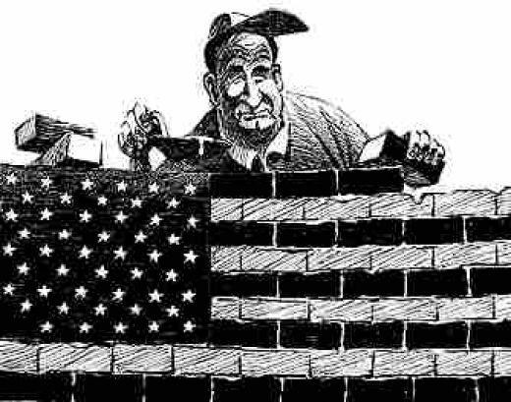
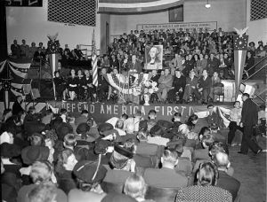

Isolationism
Policy which isolates ones nation from the economic and political affairs of others.
Prevalent within America in the 1930s as American public opinion and policy pushed towards isolationism as a result of the Great Depression and their losses in WWI.

Slide 6
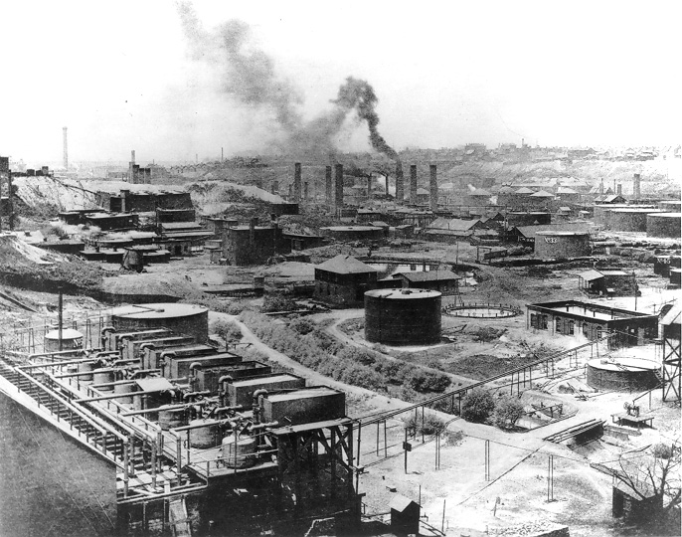
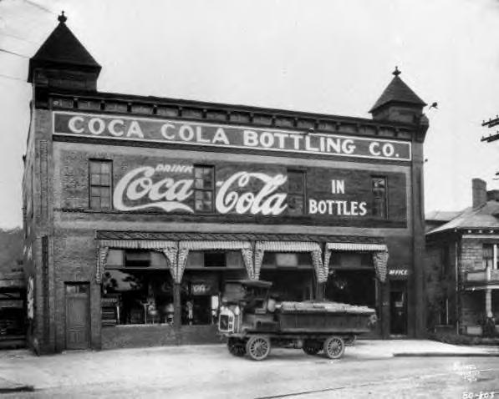
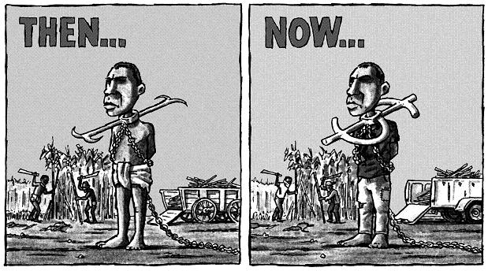
capitalism
An economic system based on the principle of individual and property rights, where all property is privately owned.
Little to no government interference and allows for there to be a class divide.
Between 1865 and 1920, the United States became the world's leading industrial capitalist nation.
In the 1800s, Americans embraced Hebert Spencer’s view of Social Darwinism to justify laissez-faire capitalism.

Slide 7
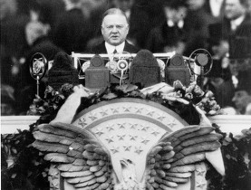
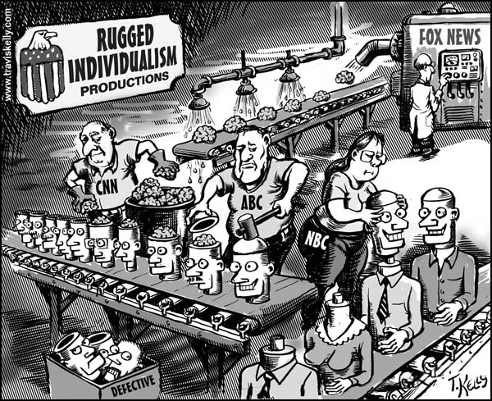
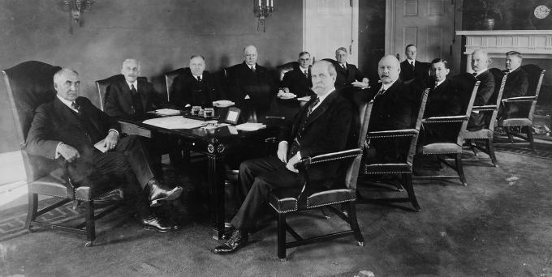
Rugged individualism
The belief that all individuals, or nearly all individuals, can succeed on their own and that government help for people should be minimal.
It was a widely used phrase by the republican president Herbert Hoover.
It is often associated with Social Darwinism.
It was a common value of the time period that people shouldn't rely on the government.

